Slide 1
CS50 Lab 3 Andrew Holmes

Slide 2
Useful info
Tutorial time
5-6pm Pfoho dhall (can be hybrid, email me if needed)
Email
aholmes@college.harvard.edu
Slack
Now created – please join, this will be best way to reach me if needed and I will post announcements/info there.

Slide 3
Today’s Logistics
PSET design review mistakes
Topic review: Sorting
Review & practice: Recursion
Lab problem - sort

Slide 4
PSET design issues
Readability
Using floats rather than ints!
Efficiency
Using isdigit, isalpha
Magic numbers
Caesar / Substitution
Magic numbers vs chars
Defining constants
Bulbs
Converting char array to int array
e.g. #define ALPHA_SIZE 26

Slide 5
Readability design issues: floats
float count_words(string text)
{
float words = 0;
for (int i = 0; i < strlen(text); i++)
{
if (isspace(text[i]))
{
words++;
}
}
words ++;
return words;
}

Slide 6
Readability design issues/ideas
int count_sentences(string text)
{
int sentences = 0;
for (int i = 0, n = strlen(text); i < n; i++)
{
if ((text[i] == '!' || text[i] == '?') || text[i] == '.')
{
sentences++;
}
}
return sentences;
}

Slide 7
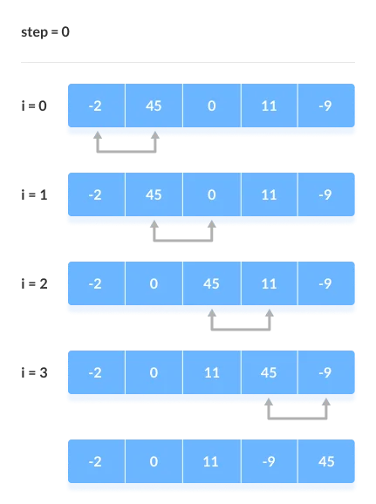
Topic review: Sorting
Bubble sort
Idea: repeatedly switch neighboring elements until sorted
Pros:
Fast if list is sorted, or close to it
Easy to code
Cons:
Worst-case runtime O(n^2)

Slide 8
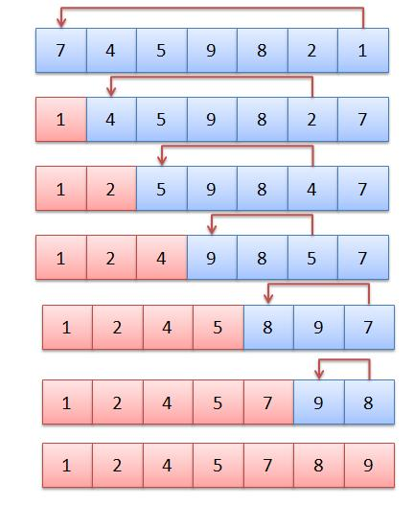
Topic review: Sorting
Selection sort
Idea: repeatedly put the smallest element at the front until sorted
Pros:
Fast if list is sorted, or close to it
Easy to code
Cons:
Worst-case runtime O(n^2)

Slide 9
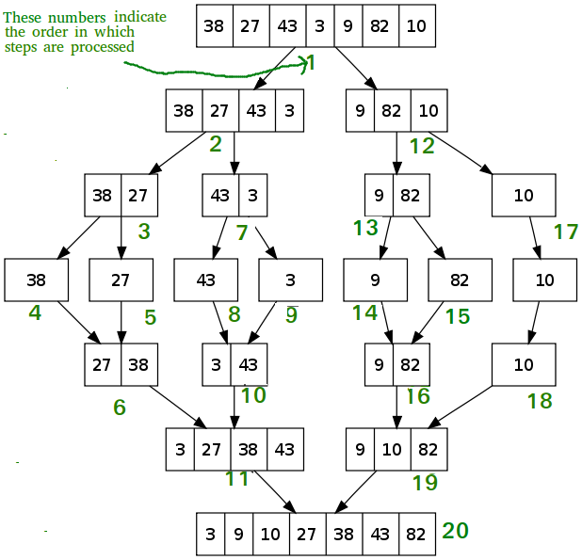
Topic review: Sorting
Merge sort
Idea: split into two parts, sort each and merge together
Pros:
Best possible asymptotic running time: O(n log n)
Cons:
Harder to implement/ understand

Slide 10
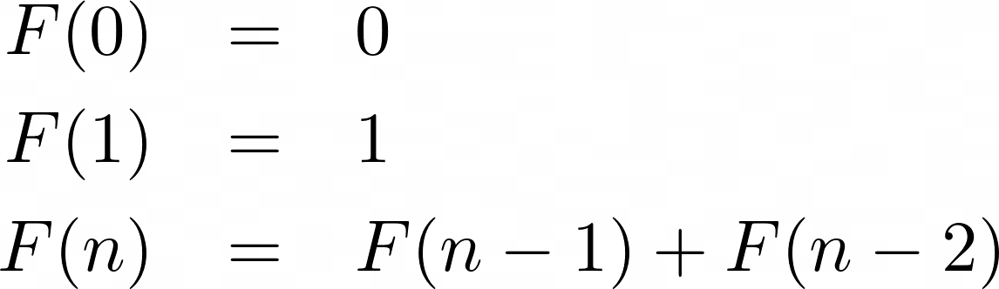
Topic review: Recursion
1, 1, 2, 3, 5, 8, 13…

Slide 11
Recursion in code
Any function that calls itself!
Int f (int x)
{
return f(x);
}
Problem?

Slide 12
Recursion tips
Two parts:
Base cases: prevent infinite recursion, act as start of sequences or similar
Recursive part: Calling the function with a different argument

Slide 13
Recursion example: Fibonacci

Slide 14
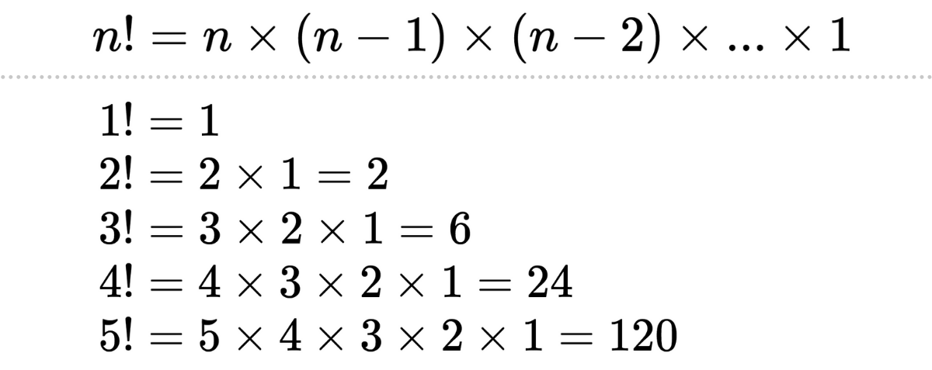
Recursion exercise: Factorial

Slide 15
Lab problem: sort
Test out the sorting algorithms seen in lecture!
https://cs50.harvard.edu/college/2022/fall/labs/3/
Work in pairs/small groups, we will reconvene shortly to see how everyone is getting on.

Slide 16
Sort solution
sort1 uses: Bubble Sort
How do you know?: On a large random file, sort1 takes much longer than an already-sorted file of the same size. For already-sorted files, sort1 returns results almost instantaneously, regardless of size. This suggests that sort1 has a different upper bound runtime than lower bound runtime. This is consistent with Bubble Sort, which runs in O(n^2) and Ω(n).
sort2 uses: Merge Sort
How do you know?: On larger random files, sort2 is the fastest of the three sorts. Since we know that Merge Sort runs in O(n log n) while Bubble Sort and Selection Sort run in the slower O(n^2), sort2 is likely Merge Sort.
sort3 uses: Selection Sort
How do you know?: On a large random file, sort3 takes just as long as sort1, but performs no better when the list is already sorted. This suggests that the algorithm runs in O(n^2) and Ω(n^2), which is consistent with Selection Sort.

Slide 17
PSET 3 pointers
Plurality
Use candidate_count not MAX
Print winner should take two for loops, one to find the max number of votes a candidate received, the second to print out all the candidates who received this number of votes
Runoff
Preferences[i][j] is the jth preference for voter i. This means preferences[0][0] is the first voter’s first choice. You may need to index into an array using preferences[i][j] as an index at some point!
Can you re-use some of your plurality code not to find the max, but find the min to determine who was eliminated?
Tideman
My best advice: don’t do this PSET. In my opinion, this is the hardest PSET relative to your level of experience at the time the PSET is released in the entire class.

Slide 18

Cya next week :D

